Slide 1

The Physical Layer: an overview Chapter 2
Application Transport Network Link Physical
Foundation on which other layers build
Properties of wires, fiber, wireless limit what the network can do
We will cover theoretical basis of data transmission.
Nature puts limits on the data sent over a channel.
Properties of channels determine the performance
Throughput, latency, error rate
We will cover three kinds of media
Guided (coper wire and fiber optics)
Wireless (terrestrial radio)
Satellite.
Key problem is to send (digital) bits using only (analog) signals
This is called modulation
We will cover communication system used by computer networks.

Slide 2
The Physical Layer
Theoretical Basis for Data Communications
Guided Transmission Media
Wireless Transmission
Communication Satellites
Digital Modulation and Multiplexing
Public Switched Telephone Network
Mobile Telephone System
Cable Television

Slide 3
Theoretical Basis for Data Communication
Communication rates have fundamental limits
Fourier analysis
Bandwidth-limited signals
Maximum data rate of a channel

Slide 4
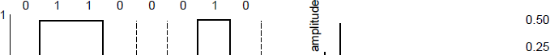
Fourier Analysis
A time-varying signal can be equivalently represented as a series of frequency components (harmonics):
=
Signal over time
a, b weights of harmonics

Slide 5
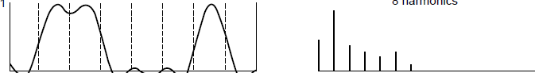
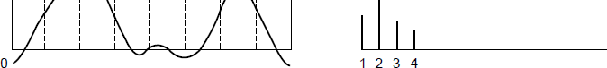
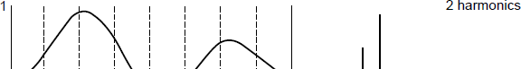
Bandwidth-Limited Signals
Having less bandwidth (harmonics) degrades the signal
8 harmonics
Lost!
Bandwidth
4 harmonics
Lost!
2 harmonics
Lost!

Slide 6
Bandwidth
Bandwidth: The range of frequencies transmitted without being strongly attenuated.
Bandwidth is the property of transmission medium
Construction, thickness, length of the medium
Example:
A telephone wise with short distances 1MHz
For each customer: 3100 Hz

Slide 7
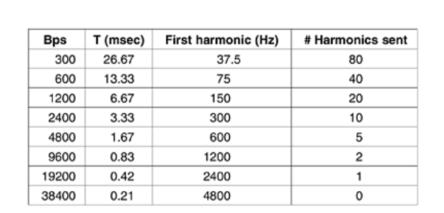
Figure 2-2. Relation between data rate and harmonics.
For some data rates, the numbers work out as shown in Fig. 2-2.
Trying to send at 9600 bps over a voice-grade telephone line will transform Fig. 2-1(a) into something looking like Fig. 2-1(c), making accurate reception of the original binary bit stream tricky.

Slide 8
Maximum Data Rate of a Channel
1924, Henry Nyquist
Perfect channel has a finite transmission capacity
He derived an equation expressing the maximum data rate of the channel
Nyquist’s theorem relates the data rate to the bandwidth (B) and number of signal levels (V)
Max. data rate = 2B log₂V bits/sec
1948, Shannon
Derived an equation expressing the maximum rate of the channel subject random noise.
Most important paper in information theory
Shannon's theorem relates the data rate to the bandwidth (B) and signal strength (S) relative to the noise (N):
Max. data rate = B log₂(1 + S/N) bits/sec

Slide 9
Guided Transmission (Wires & Fiber)
Media have different properties, hence performance
Storage media
Wires:
Twisted pairs
Coaxial cable
Power lines
Fiber cables

Slide 10
Reality Check: Storage media
Send data on tape / disk / DVD for a high bandwidth link
Mail one box with 1000 800GB tapes (6400 Tera bits)
Takes one day to send (86,400 secs)
Data rate/bandwidth is 70 Gbps.
Data rate is faster than long-distance networks! It is also cheap. But, the message delay is very poor.

Slide 11



Wires – Twisted Pair
Very common; used in LANs, telephone lines
Twists reduce radiated signal (interference)
Common application is telephone system and ADSL (Asymmetric Digital Subscriber Line)
Can be used to transmit both analog and digital signals
Bandwidth depends on the thickness of wire and distance travelled
But, bandwidth of several megabits/sec can be achieved for few kilometers.
Low cost and reasonable performance
Category 5 UTP cable with four twisted pairs

Slide 12
Link Terminology
Full-duplex link
Used for transmission in both directions at once
e.g., use different twisted pairs for each direction
Half-duplex link
Both directions, but not at the same time
e.g., senders take turns on a wireless channel
Simplex link
Only one fixed direction at all times; not common

Slide 13
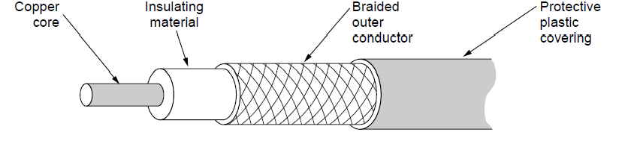
Wires – Coaxial Cable (“Co-ax”)
A coaxial cable consists of still copper wire as a core, surrounded by an insulating material.
Greater bandwidth than twisted pair
Better shielding and more bandwidth for longer distances and higher rates than twisted pair.
Bandwidth depends on cable quality and length
Bandwidth is up to 1GHz
Also common in long distance lines, cable lines, television networks.

Slide 14
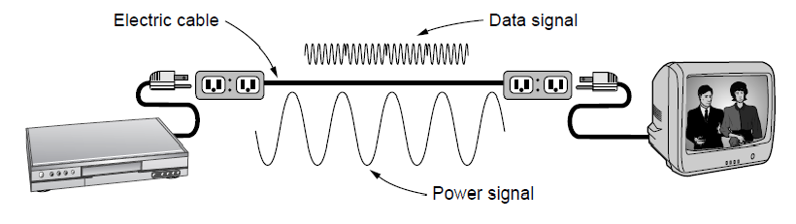
Wires – Power Lines
Household electrical wiring is another example of wires
Convenient to use, but horrible for sending data
50-60 Hz
Interference will be more, wires act like an antenna
Efforts are going on

Slide 15




Fiber Cables (1)
CPU speed has improved from 4.77 MHz ( in the year 1981) to 3 GHz. Increased by a factor of 2500.
Similarly, communication speed went from 45Mbps (telephone) to 100Gbps.Common for high rates and long distances and error rate went from 10^-5 to zero.
Achievable bandwidth with fiber is 50,000 Gbps and difficult to reach. So, many channels are employed over a single fiber.
Light source, transmission medium and detector
Light pulses are transmitted (presence=1 absence=0)
Transmission medium is unltra-thin fiber of glass.
Long distance ISP links, Fiber-to-the-Home
Light carried in very long, thin strand of glass (glass is made from sand and so cheap)
Light source (LED, laser)
Light trapped by total internal reflection
Photodetector

Slide 16
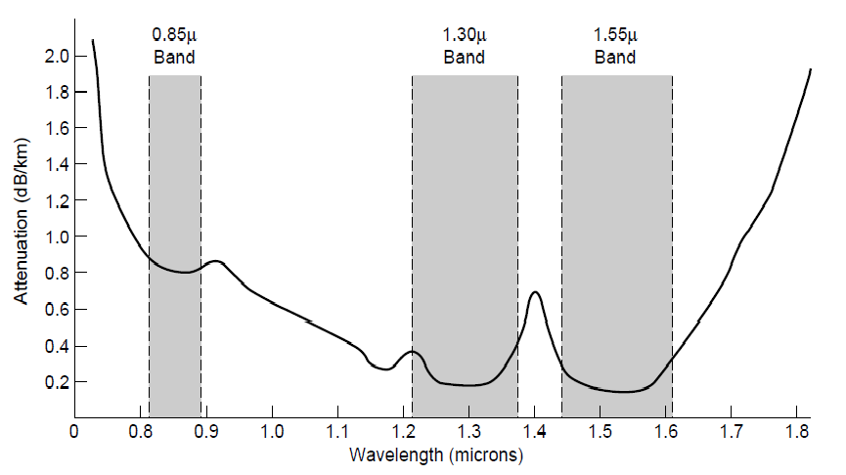
Fiber Cables (2)
Fiber has enormous bandwidth (THz) and tiny signal loss – hence high rates over long distances

Slide 17
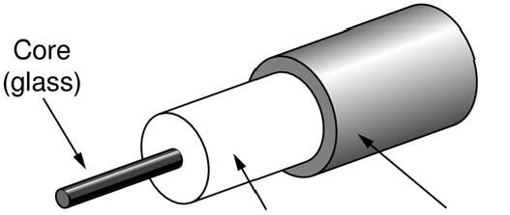

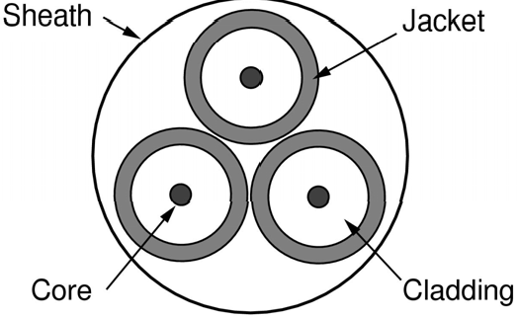
Fiber Cables (3)
Single-mode
Core so narrow (10um) light can’t even bounce around
Used with lasers for long distances, e.g., 100km
Multi-mode
Other main type of fiber
Light can bounce (50um core)
Used with LEDs for cheaper, shorter distance links
Fibers in a cable

Slide 18
Fiber Cables (4)
Comparison of the properties of wires and fiber:
Property | Wires | Fiber
Distance | Short (100s of m) | Long (tens of km)
Bandwidth | Moderate | Very High
Cost | Inexpensive | Less cheap
Convenience | Easy to use | Less easy
Security | Easy to tap | Hard to tap

Slide 19
Wireless Transmission
Electromagnetic Spectrum »
Radio Transmission »
Microwave Transmission »
Light Transmission »
Wireless vs. Wires/Fiber »

Slide 20
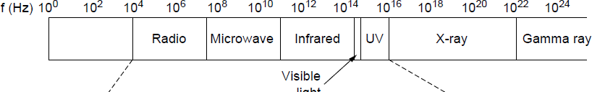
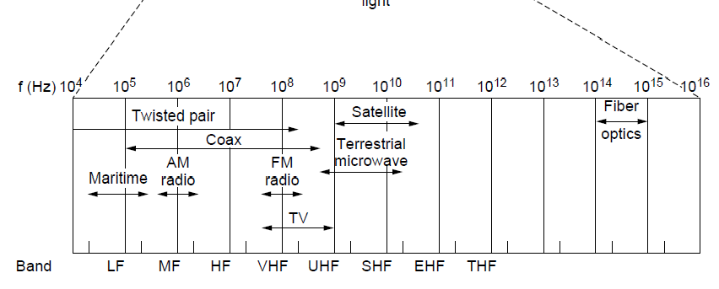
Electromagnetic Spectrum (1)
Different bands have different uses:
Radio: wide-area broadcast; Infrared/Light: line-of-sight
Microwave: LANs and 3G/4G;
Networking focus
Microwave

Slide 21
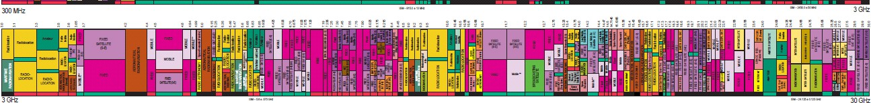

Electromagnetic Spectrum (2)
To manage interference, spectrum is carefully divided, and its use regulated and licensed, e.g., sold at auction.
300 MHz
3 GHz
WiFi (ISM bands)
3 GHz
Source: NTIA Office of Spectrum Management, 2003
30 GHz
Part of the US frequency allocations

Slide 22
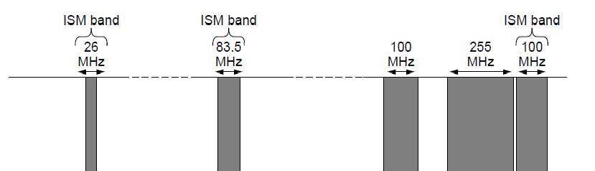

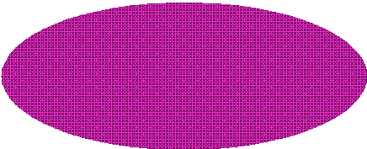
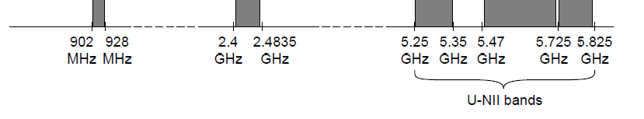
Electromagnetic Spectrum (3)
Fortunately, there are also unlicensed (“ISM”) bands:
Free for use at low power; devices manage interference
Widely used for networking; WiFi, Bluetooth, Zigbee, etc.
802.11
b/g/n
802.11a/g/n
Industrial, scientific and medical networks (ISM networks)

Slide 23


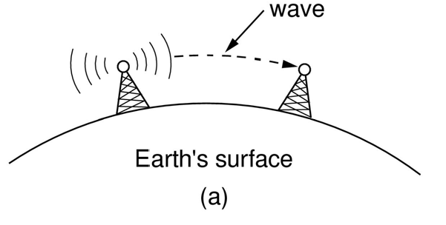
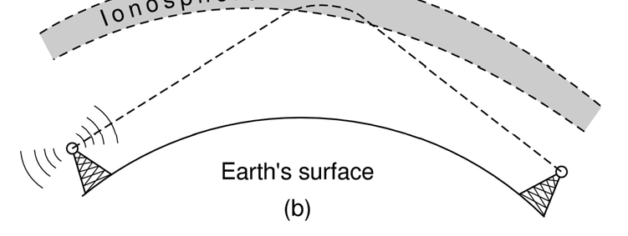
Radio Transmission
Radio signals penetrate buildings well and propagate for long distances with path loss (attenuation)
At high frequencies, radio waves travel in a straight line.
At all frequencies radio waves pass through obstacles, but power falls sharply
In the VLF, LF, and MF bands, radio waves follow the curvature of the earth
In the HF band, radio waves bounce off the ionosphere.

Slide 24
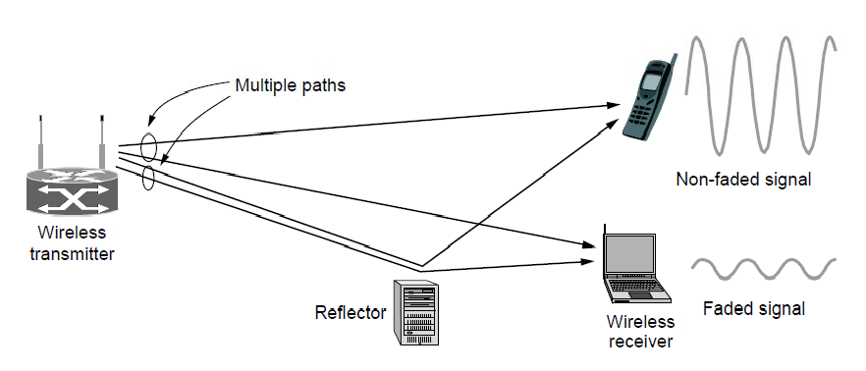
Microwave Transmission
Microwaves have much bandwidth and are widely used indoors (WiFi) and outdoors (3G, satellites)
Signal is attenuated/reflected by everyday objects
Strength varies with mobility due multipath fading, etc.

Slide 25

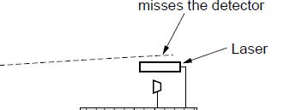
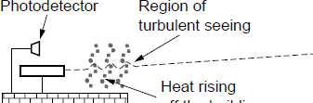
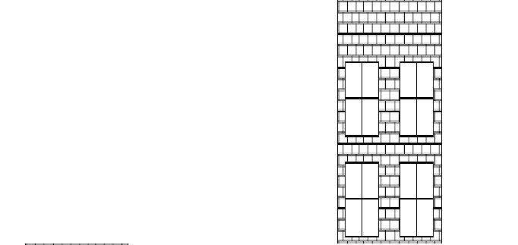
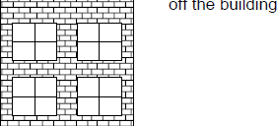
Light Transmission
Line-of-sight light (no fiber) can be used for links
Light is highly directional, has much bandwidth
Use of LEDs/cameras and lasers/photodetectors

Slide 26
Wireless vs. Wires/Fiber
Wireless:
+ Easy and inexpensive to deploy
+ Naturally supports mobility
+ Naturally supports broadcast
Transmissions interfere and must be managed
Signal strengths hence data rates vary greatly
Wires/Fiber:
+ Easy to engineer a fixed data rate over point-to-point links
Can be expensive to deploy, esp. over distances
Doesn’t readily support mobility or broadcast

Slide 27
Communication Satellites
Satellites are effective for broadcast distribution and anywhere/anytime communications
Kinds of Satellites »
Geostationary (GEO) Satellites »
Low-Earth Orbit (LEO) Satellites »
Satellites vs. Fiber »

Slide 28
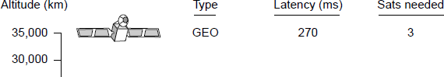
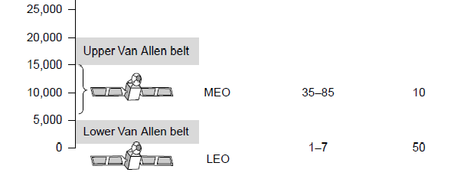
Kinds of Satellites
Satellites and their properties vary by altitude:
Geostationary (GEO), Medium-Earth Orbit (MEO), and Low-Earth Orbit (LEO)
Sats needed for global coverage

Slide 29
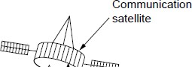
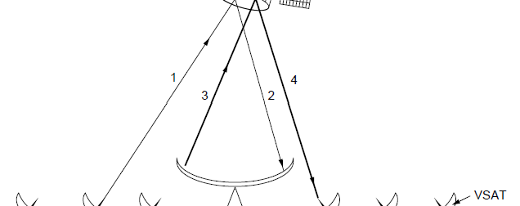

Geostationary Satellites
GEO satellites orbit 35,000 km above a fixed location
VSAT (computers) can communicate with the help of a hub
Different bands (L, S, C, Ku, Ka) in the GHz are in use but may be crowded or susceptible to rain.
GEO satellite
VSAT
A very small aperture terminal (VSAT) is a small-sized earth station used in the transmit/receive of data, voice and video signals over a satellite communication network, excluding broadcast television

Slide 30
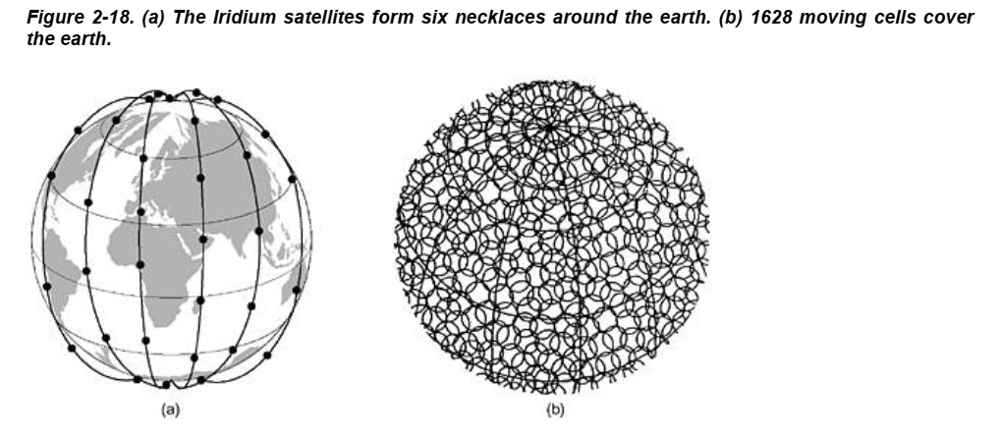
Low-Earth Orbit Satellites
Systems such as Iridium use many low-latency satellites for coverage and route communications via them
Positioned above 750KM

Slide 31
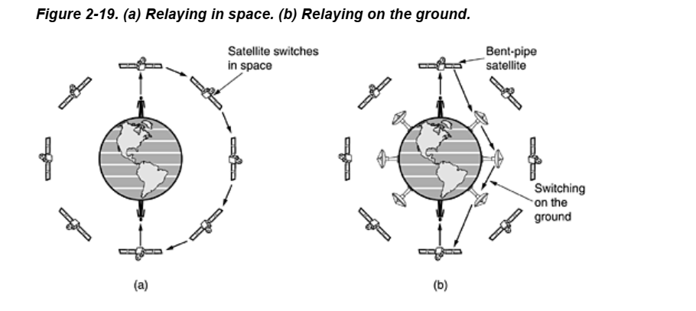
Alternative design: Easier to manage from the ground

Slide 32
Satellite vs. Fiber
Satellite:
+ Can rapidly set up anywhere/anytime communications (after satellites have been launched)
+ Can broadcast to large regions
Limited bandwidth and interference to manage
Fiber:
+ Enormous bandwidth over long distances
Installation can be more expensive/difficult

Slide 33
Digital Modulation and Multiplexing
Process of converting between bits and signals is called modulation.
multiplexing schemes share a channel among users.
Baseband Transmission »
Passband Transmission »
Frequency Division Multiplexing »
Time Division Multiplexing »
Code Division Multiple Access »

Slide 34
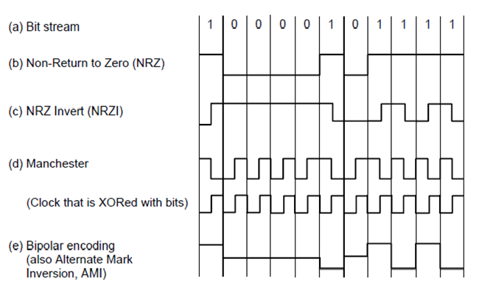
Baseband Transmission
Line codes send symbols that represent one or more bits
NRZ (non-return-to-zero) is the simplest, literal line code (+1V=“1”, -1V=“0”)
Other codes tradeoff bandwidth and signal transitions
Four different line codes

Slide 35
Clock Recovery
To decode the symbols, signals need sufficient transitions
Otherwise long runs of 0s (or 1s) are confusing, e.g.:
1
0 0 0 0 0 0 0 0 0 0 um, 0? er, 0?
Strategies:
Manchester coding, mixes clock signal in every symbol
4B/5B maps 4 data bits to 5 coded bits with 1s and 0s:
Data | Code | Data | Code | Data | Code | Data | Code
0000 | 11110 | 0100 | 01010 | 1000 | 10010 | 1100 | 11010
0001 | 01001 | 0101 | 01011 | 1001 | 10011 | 1101 | 11011
0010 | 10100 | 0110 | 01110 | 1010 | 10110 | 1110 | 11100
0011 | 10101 | 0111 | 01111 | 1011 | 10111 | 1111 | 11101
Scrambler XORs tx/rx data with pseudorandom bits

Slide 36
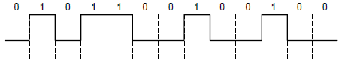
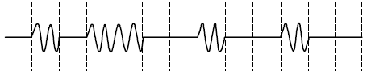
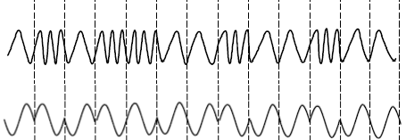
Passband Transmission (1)
Modulating the amplitude, frequency/phase of a carrier signal sends bits in a (non-zero) frequency range
NRZ signal of bits Amplitude shift keying Frequency shift keying Phase shift keying

Slide 37
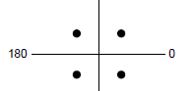
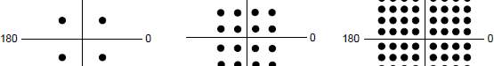
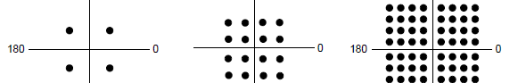

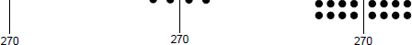
Passband Transmission (2)
Constellation diagrams are a shorthand to capture the amplitude and phase modulations of symbols:
BPSK
QPSK
4 symbols
QAM-16
16 symbols
QAM-64
2 symbols
64 symbols
1 bit/symbol 2 bits/symbol
BPSK/QPSK varies only phase
4 bits/symbol 6 bits/symbol
QAM varies amplitude and phase

Slide 38
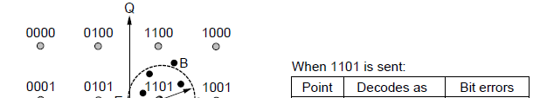
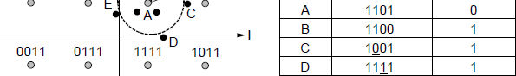
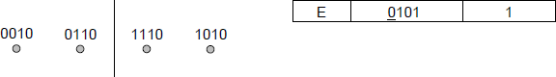
Passband Transmission (3)
Gray-coding assigns bits to symbols so that small symbol errors cause few bit errors:
B
E
A
C
D

Slide 39
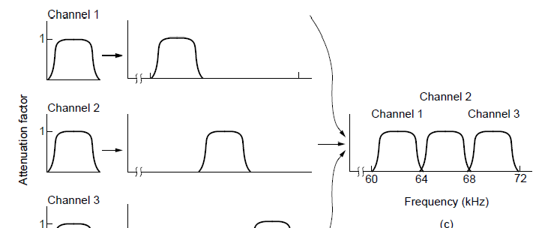
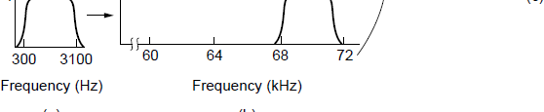
Frequency Division Multiplexing (1)
FDM (Frequency Division Multiplexing) shares the channel by placing users on different frequencies:
Overall FDM channel

Slide 40
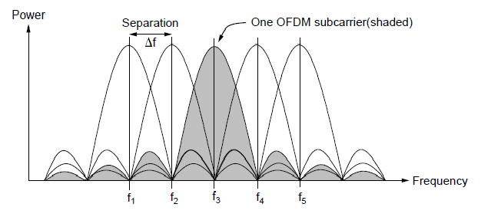
Frequency Division Multiplexing (2)
OFDM (Orthogonal FDM) is an efficient FDM technique used for 802.11, 4G cellular and other communications
Subcarriers are coordinated to be tightly packed

Slide 41
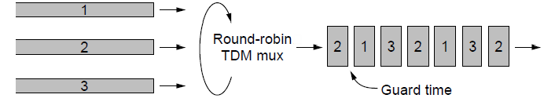
Time Division Multiplexing (TDM)
Time division multiplexing shares a channel over time:
Users take turns on a fixed schedule; this is not packet switching or STDM (Statistical TDM)
Widely used in telephone / cellular systems

Slide 42
Code Division Multiple Access (CDMA)
CDMA shares the channel by giving users a code
Codes are orthogonal; can be sent at the same time
Widely used as part of 3G networks
Sender Codes Transmitted Receiver Decoding
Signal
_{A =} +1 +1
S x A
0
+2+2
Sum = 4
A sent “1”
-1
-1
0
+2
+1 +1
0
S x B
0
Sum = -4
B sent “0”
B =
0
0
-1 -1
-2 -2
-2
_{C =} +1
+1
S = +A -B
S x C
0
+2
Sum = 0
C didn’t send
-1 -1
0
-2

Slide 43
The Public Switched Telephone Network
Structure of the telephone system »
Politics of telephones »
Local loop: modems, ADSL, and FTTH »
Trunks and multiplexing »
Switching »

Slide 44
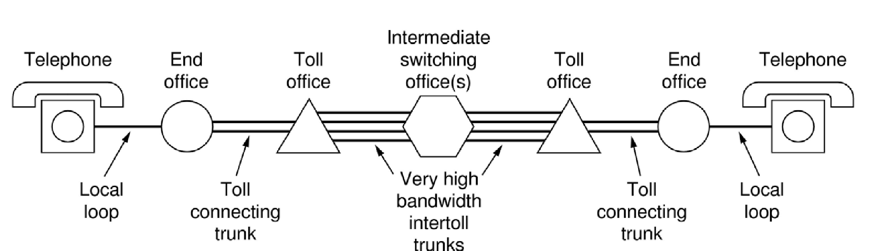
Structure of the Telephone System
A hierarchical system for carrying voice calls made of:
Local loops, mostly analog twisted pairs to houses
Trunks, digital fiber optic links that carry calls
Switching offices, that move calls among trunks

Slide 45
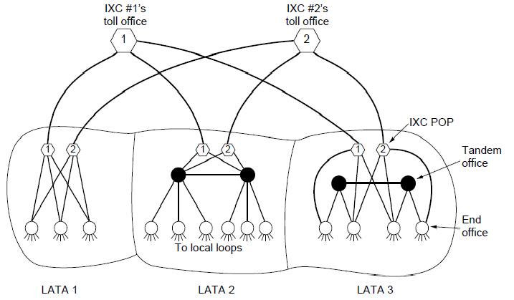
The Politics of Telephones
In the U.S., there is a distinction for competition between serving a local area (LECs) and connecting to a local area (at a POP) to switch calls across areas (IXCs)
Customers of a LEC can dial via any IXC they choose
POP: Point of presence
LEC: Local Exchange Career
IXC: Inter Exchange Career

Slide 46
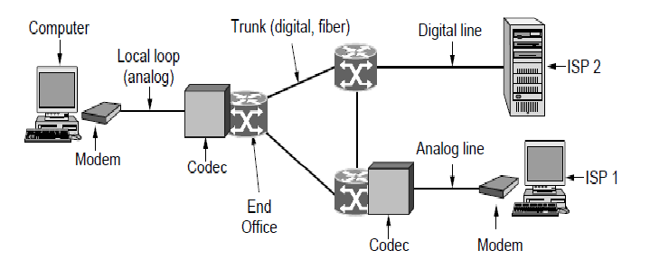
Local loop (1): modems
Telephone modems send digital data over an 3.3 KHz analog voice channel interface to the POTS (Plain Old Telephone service)
Rates <56 kbps; early way to connect to the Internet

Slide 47
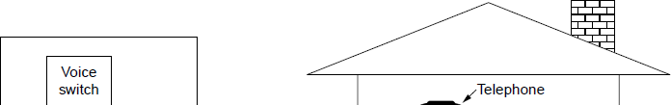
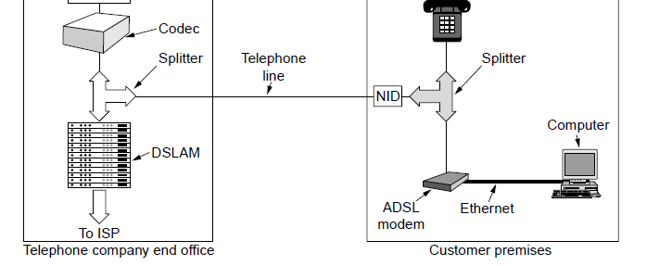
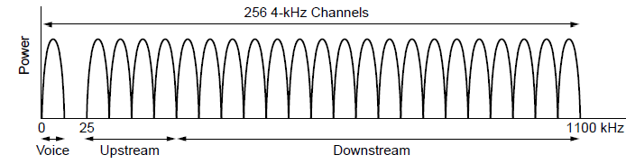
Local loop (2): Digital Subscriber Lines
DSL broadband sends data over the local loop to the local office using frequencies that are not used for POTS
Telephone/computers attach to the same old
phone line
Rates vary with line
− ADSL2 up to 12 Mbps
OFDM is used up to
1.1 MHz for ADSL2
− Most bandwidth down
OFDM: Orthogonal Frequency Division Multiplexing
POTS: an analog voice transmission phone system implemented over copper twisted pair wires.

Slide 48


Local loop (3): Fiber To The Home
FTTH (Fiber To The Home) broadband relies on deployment of fiber optic cables to provide high data rates customers
One wavelength can be shared among many houses
Fiber is passive (no amplifiers, etc.)

Slide 49

Trunks and Multiplexing (1)
Calls are carried digitally on PSTN trunks using TDM
A call is an 8-bit PCM sample each 125 μs (64 kbps)
Traditional T1 carrier has 24 call channels each 125
μs (1.544 Mbps) with symbols based on AMI
PSTN: Public Switched Telephone Network

Slide 50

Trunks and Multiplexing (2)
SONET (Synchronous Optical NETwork) is the worldwide standard for carrying digital signals on optical trunks
Keeps 125 μs frame; base frame is 810 bytes (52Mbps)
Payload “floats” within framing for flexibility

Slide 51

Trunks and Multiplexing (3)
Hierarchy at 3:1 per level is used for higher rates
Each level also adds a small amount of framing
Rates from 50 Mbps (STS-1) to 40 Gbps (STS-768)
SONET/SDH rate hierarchy

Slide 52

Trunks and Multiplexing (4)
WDM (Wavelength Division Multiplexing), another name for FDM, is used to carry many signals on one fiber:

Slide 53




Switching (1)
PSTN uses circuit switching; Internet uses packet switching
PSTN:
Internet:

Slide 54



Switching (2)
Circuit switching requires call setup (connection) before data flows smoothly
Also teardown at end (not shown)
Packet switching treats messages independently
No setup, but variable queuing delay at routers
Circuits
Packets

Slide 55

Switching (3)
Comparison of circuit- and packet-switched networks

Slide 56
Mobile Telephone System
Generations of mobile telephone systems »
Cellular mobile telephone systems »
GSM, a 2G system »
UMTS, a 3G system »

Slide 57
Generations of mobile telephone systems
1G, analog voice
AMPS (Advanced Mobile Phone System) is example, deployed from 1980s. Modulation based on FM (as in radio).
2G, analog voice and digital data
GSM (Global System for Mobile communications) is example, deployed from 1990s. Modulation based on QPSK.
3G, digital voice and data
UMTS (Universal Mobile Telecommunications System) is example, deployed from 2000s. Modulation based on CDMA
4G, digital data including voice
LTE (Long Term Evolution) is example, deployed from 2010s. Modulation based on OFDM

Slide 58

Cellular mobile phone systems
All based on notion of spatial regions called cells
Each mobile uses a frequency in a cell; moves cause handoff
Frequencies are reused across non-adjacent cells
To support more mobiles, smaller cells can be used
Cellular reuse pattern
Smaller cells for dense mobiles

Slide 59

GSM – Global System for Mobile Communications (1)
Digital voice, Sophisticated technology
Mobile is divided into handset and SIM card (Subscriber Identity Module) with credentials
Mobiles tell their HLR (Home Location Register) their current whereabouts for incoming calls
Cells keep track of visiting mobiles (in the Visitor LR)

Slide 60


GSM – Global System for Mobile Communications (2)
Air interface is based on FDM channels of 200 KHz divided in an eight-slot TDM frame every 4.615 ms
Mobile is assigned up- and down-stream slots to use
Each slot is 148 bits long, gives rate of 27.4 kbps

Slide 61




UMTS – Universal Mobile Telecommunications System (1)
Voice and data
UMTS Architecture is an evolution of GSM (Global System for Mobile communication); terminology differs Packets goes to/from the Internet via SGSN/GGSN
The gateway GPRS support node (GGSN) converts the incoming data traffic coming from the mobile users through the Service gateway GPRS support node (SGSN) and forwards it to the relevant network, and vice versa. The GGSN and the SGSN together form the GPRS support nodes (GSN).
GPRS: General Packet Radio Services (GPRS)
Internet

Slide 62


UMTS – Universal Mobile Telecommunications System (2)
Air interface based on CDMA over 5 MHz channels
Rates over users <14.4 Mbps (HSPDA) per 5 MHz
CDMA allows frequency reuse over all cells
CDMA permits soft handoff (connected to both cells)
Soft handoff

Slide 63
Cable Television
Internet over cable »
Spectrum allocation »
Cable modems »
ADSL vs. cable »

Slide 64


Internet over Cable
Internet over cable reuses the cable television plant
Data is sent on the shared cable tree from the head- end, not on a dedicated line per subscriber (DSL)
ISP
(Internet)

Slide 65

Spectrum Allocation
Upstream and downstream data are allocated to frequency channels not used for TV channels:

Slide 66

Cable Modems
Internet access requires cable modem.
Cable modems at customer premises implement the physical layer of the DOCSIS (data over cable service interface specification) standard
Modem to computer is normally ethernet or USB. The other uses all of FDM,TDM and CDMA to share the bandwidth of the cable among the subscribers.

Slide 67
Cable vs. ADSL
ADSL (Asymmetric Digital Subscriber Line) is a technology that facilitates fast data transmission at a high bandwidth on existing copper wire telephone lines to homes and businesses.
Cable:
+ Uses coaxial cable to customers (good bandwidth)
Data is broadcast to all customers (less secure)
Bandwidth is shared over customers so may vary
ADSL:
+ Bandwidth is dedicated for each customer
+ Point-to-point link does not broadcast data
Uses twisted pair to customers (lower bandwidth)

Slide 68
Summary
Physical layer is the basis of all networks
Nature imposes two limits to determine bandwidth
Nyquist limit which deals with noiseless channels
Shannon limit which deals with noisy channels
Transmission media can be guided or unguided
Guided: twisted pair, coaxial cable, and fiber optics
Unguided: radio, microwaves, infrared, laser through air and satellites.
Digital modulation methods send bits over guided and unguided media
Line codes operate at baseband, and signals can be placed in a passband by modulating the amplitude, frequency, and phase of the career.
Telephone system is the basis for wide area networks
Main components: local loops, trunks, and switches
ADSL offers speeds upto 40Mbps better than local loop
PONN brings fiber to home even greater access rates than ADSL
Trunks carry digital information. They are multiplexed with WDM and provide many high capacity links over fibers as well as TDM to share each high data rate link between users.

Slide 69
Summary
Both circuit switching and packet switching is important
For mobile applications, the fixed telephone system is not suitable.
Mobile phones have gone through three generations: 1G, 2G, 3G
Cable television system is alternative system for network access. Bandwidth depends on other users as it is shared among the users.

Slide 70
Chapter 2
End

